Slide 1

Reinventing the wheel. Descriptions of autism in non-autism research
Autscape, 14.08.2019
Kosma Moczek
JASNA STRONA SPEKTRUM
Notes:
Kosma Moczek, aged 32, Poland
Background #1: informal lead of self-advocacy movement
Background #2: friends with top class researchers
Background #3: I’m an engineer and systemizer (hi Maqqi!)
Fact: I connect the dots.
Fact: The dots around autism have historically had the dots connected all wrong. Hence the topic.

Slide 2
Heads-up
Notes:
Fair bit of heads-up/warning: this is not a scientific presentation. I’m here to inspire research… I don’t have all the answers yet. Many of my ideas come from other people who are also still developing their ideas (thanks Joanna!).
Another bit of warning: I’m Eastern European. I’ll use sarcasm a lot (British-compatible), but also be very direct sometimes (not British-compatible). Blame it on cultural differences.

Slide 3
„If I have seen further than others, it was by standing upon the shoulders of giants.”
- attributed to Isaac Newton
Notes:
()

Slide 4
Pervasive
Developmental
Disorder
Notes:
We’re here to talk about ASD, which is called PDD or developmental difference depending on who you’re talking with.
The wording is unfortunate, but the clues are still there.

Slide 5
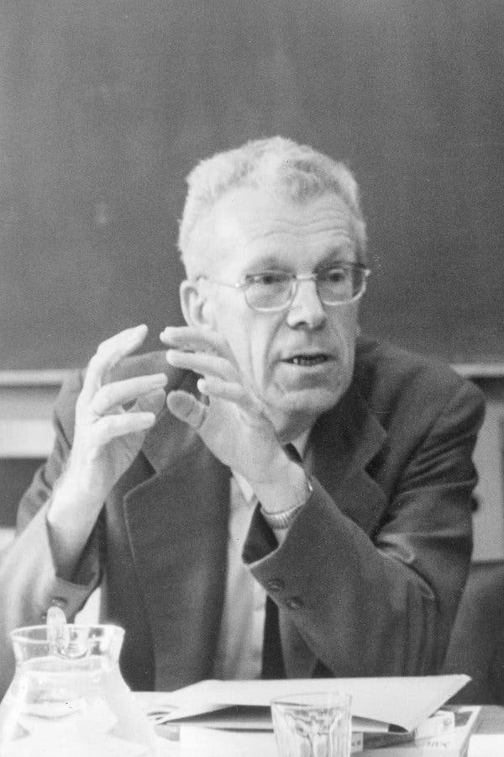
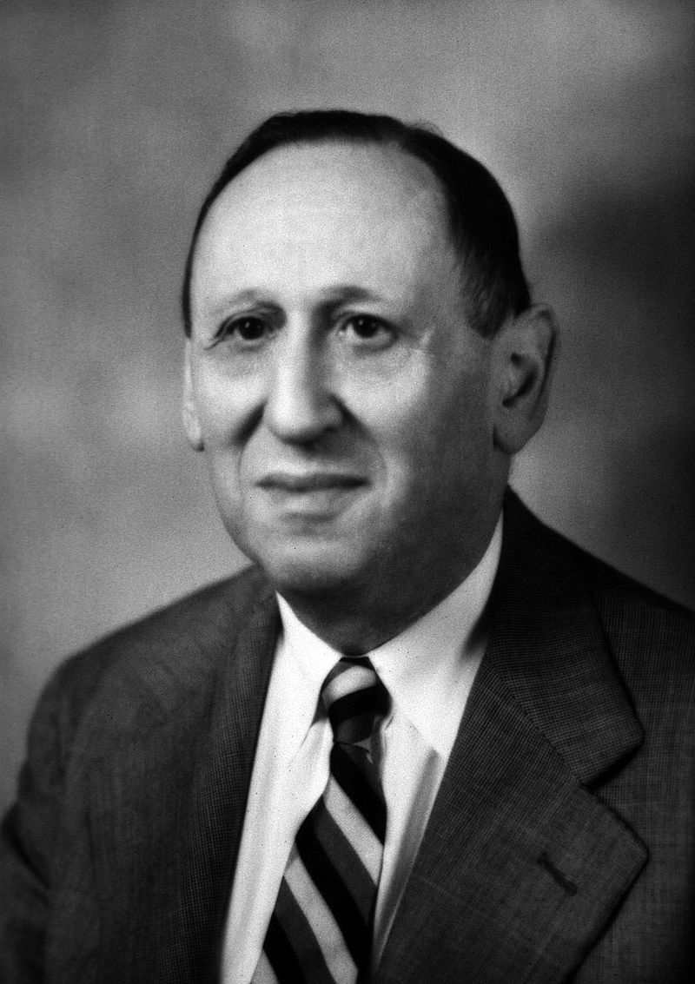

Notes:
Do you know these people?
Controversial, but famous.
[Asperger, Kanner, Attwood]

Slide 6
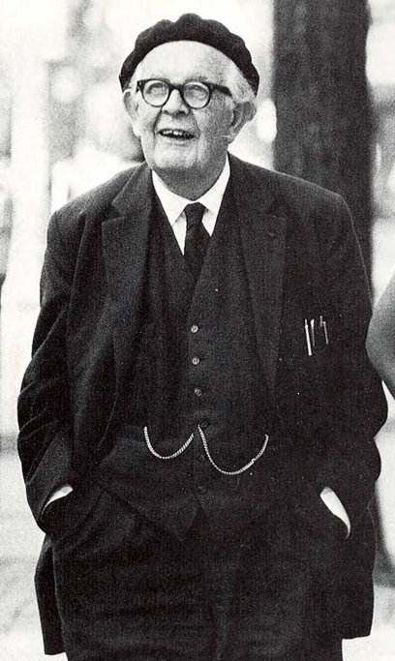
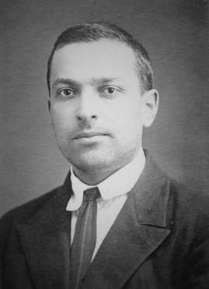
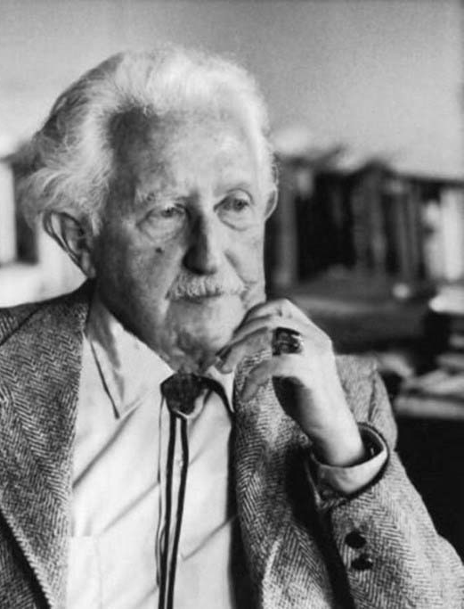
Notes:
How about these guys?
Raise your hands.
These are the big brain heads of developmental psychology.
[Piaget, Vygotsky, Erikson]

Slide 7
Naïve.
Notes:
We as autism researchers don’t stand on the shoulders of giants because we fail to recognize who our giants are.
We build naive models.
Models tend to “fan-out” - starting from autism and building from there - but fail to “fan-in”, or take existing knowledge in consideration.
Even worse - with very few dots, people start creating false conclusions.

Slide 8
Human Development 101

Slide 9
There are established theories and literature on the development of:
Emotions
Empathy
Language
Communication
Sensory and motor skills
Self-knowledge
Identity
Personality
Relationships
Notes:
This is nothing new, we’ve known this stuff for decades, if not centuries.
No, wait, this is an autism conference. Let me start again.

Slide 10
There are established theories and literature on the development of:
Emotions
Empathy
Language
Communication
Sensory and motor skills
Self-knowledge
Identity
Personality
Relationships
Notes:
How about…

Slide 11
Autistic people stuggle with:
Emotions
Empathy
Language
Communication
Sensory and motor skills
Self-knowledge
Identity
Personality
Relationships
Notes:
NT person has a problem? Consult the NT knowledge.
ND person has a problem? Consult the ND knowledge.

Slide 12
A Paradox.
Autistic humans are still humans.
Autistic humans require special autistic support.
Notes:
This would be funny if it didn’t stop us from treating all the autism-related problems.
Let’s start with a bit of a case study.

Slide 13
Case: GI problems

Slide 14
FAD DIETS
SENSIBLE DIETARY
ADVICE
GI PROBLEMS
AUTISM
ANXIETY
MEDICATION
THERAPY
Notes:
We don’t know the cause, but we know they are comorbid.
We have some other problems as well.
We attempt to throw solutions at the problems.
This model represents our reality… it’s not working terribly well.
Let’s fix it a little.

Slide 15
AUTISM
INCOMPATIBLE
ENVIRONMENT
STRESS
ANXIETY
Notes:
We know this.
It’s hard to argue with.
But… what about the existing science of GI problems?
What if we stop trying to be smart and just use the existing knowledge?

Slide 16
INFECTIONS
STRESS
LIFESTYLE
GI PROBLEMS
DIET
GENETICS
Notes:
This is what would happen if a neurotypical person came to a doctor with GI problems.
NOT A COMPLETE MODEL.
Low-hanging fruit are checked first.
„Have you been you stressed recently?”
When autism comes into play, people lose their minds and go against any logic.

Slide 17
AUTISM
INCOMPATIBLE
ENVIRONMENT
GENETIC
STRESS
ANXIETY
GI PROBLEMS
Notes:
How about this?
A new path explains *a lot*.
And guess what…

Slide 18
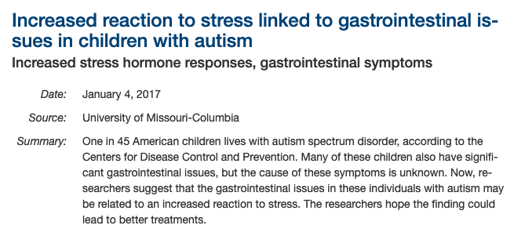
DOI:10.1016/j.bbi.2016.05.009
Notes:
This aligns with our practice.
In many cases, overfocusing on the eating/GI side makes things more stressful, further deepening the symptoms.
WE LITERALLY APPLIED EXISTING KNOWLEDGE THAT’S BEEN KNOWN FOR CENTURIES

Slide 19

Notes:
As I mentioned, it’s usually obvious in hindsight… but someone had to connect the dots first.
In many cases, it’s hard to even get the truth accepted. Often people don’t want truth, but hope and miracles.
It’s hard to see the big picture when you’re in immediate distress and only see the immediate problem.
Without enough dots it’s easy to either start inventing them or making false conclusions (drawing lines where there should be none).

Slide 20
Know your dots!
developmental psychology
psychopathology
psychiatry
psychology in general
medicine in general
sociology (sic)
Notes:
You can’t connect dots if you don’t have any dots.
This is called domain knowledge.

Slide 21
Case:
Autistic Meltdown
Autistic Shutdown
Autistic Burnout
Notes:
I’m always wary of any invented term that starts with „autistic”.
Don’t get me wrong: it’s good that autistic people are describing their experiences and trying to form a vocabulary, but at the same time…
Creating a model without possessing domain knowledge leads to a very limited model.

Slide 22
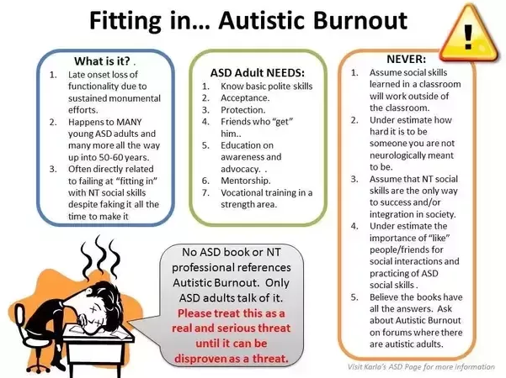
Notes:
Someone collected what they knew on the subject - good work! - but then they got stuck.
“This is a new topic, not researched, not described in literature.”
…or is it?

Slide 23
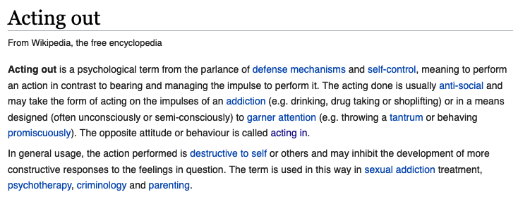
Notes:
Sorry for the Wikipedia article.
This is not a „new” subject… it’s just not in the popular psychology.
People dealing with „problematic” behaviour in non-autistic people have dealt with this for years.

Slide 24
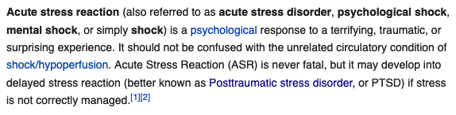

Slide 25
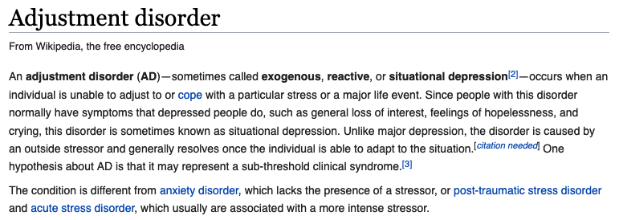
Notes:
Hello?

Slide 26
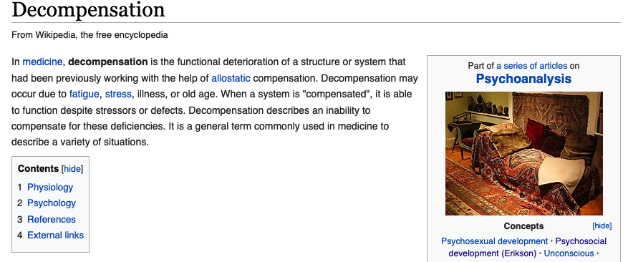
Notes:
THIS IS NOTHING NEW IF YOU ARE A PSYCHIATRIST.

Slide 27
Coping.
(or not coping)
Notes:
Meltdown is a result of compensation mechanism depletion.
The causes of distress are different in autistic people - but the dynamics of the process are pretty much the same.
Unfortunately we’re at risk as we have less compensation mechanisms, our social support networks are weaker, and some of our coping methods are called bad and actively discouraged.
It takes tons of field/domain expertise, and pretty wide horizons, to understand this.

Slide 28
Case: Autistic Masking
Notes:
* The term “masking” itself was first used in 1969/1972. Fairly recent.
Except… this is not a new concept. It dates back to (at least) Jung. (Persona)
Yes, Jung it’s outdated, but it’s still pretty much essential knowledge.
Digging further… the term “alter ego” is Latin, meaning 1st century Rome.
Why do we even call it *autistic* masking in the first place?

Slide 29
Case: Autistic Regression
Notes:
If all you have is a hammer, all problems start looking like nails.
In a neurotypical child, a sudden loss of skills is usually caused by some big event/upset. Literature calls for searching for that upset and remedying it.
The “autistic” literature fails to recognize it, or tries blaming wrong causes.

Slide 30
Case: Autistic Regression
Notes:
Case: autistic child in the middle of parents’ divorce.
I can’t stress enough: this stuff is well-described by existing literature… just not *autistic* literature.
*Anyone* in crisis will lose skills; especially of the situation exceeds the ability to cope.

Slide 31
„Autism traits”???
Black and white thinking
Impulsive and dangerous behaviours
Intense or uncontrollable emotional reactions
Avoiding social and emotional contact
Lack of empathy
Limited ability to express feelings and emotions
Cold and reserved approach
Tendency for solitary or reserved lifestyle
Detachment and apathy
Anxious attachment style
Frequently accompanied by depression, anxiety, anger, substance abuse, or rage
Notes:
Do these looks familiar?
I pulled them from…

Slide 32
Personality disorder traits
Black and white thinking
Impulsive and dangerous behaviours
Intense or uncontrollable emotional reactions
Avoiding social and emotional contact
Lack of empathy
Limited ability to express feelings and emotions
Cold and reserved approach
Tendency for solitary or reserved lifestyle
Detachment and apathy
Anxious attachment style
Frequently accompanied by depression, anxiety, anger, substance abuse, or rage
Notes:
If any of the above happens - perhaps we should look into the development process, see if there are some obstacles, hidden traumas, abuse, some basic needs not being met?
These are not autism - yet they are common descriptions of autism.
PDs are more common on the autism.
The medical model of PDs is bad; there are way better models of progression and pathology.

Slide 33
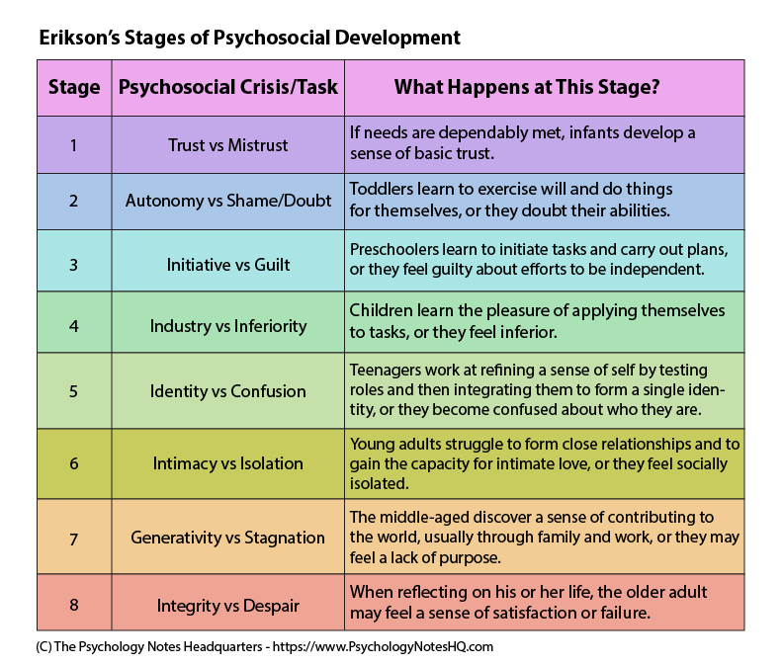
Notes:
This is Erikson’s development model, simplified almost too much to be useful… but I’ll use it anyway.
(Thanks Joanna, she showed me this).
IT GOES WRONG AT EVERY DAMN STAGE. (explain)
THIS IS NOT AUTISM, THIS APPLIES TO EVERY HUMAN.
We’re just way worse off.

Slide 34
“What we have not named, will elude us.”
- W.H.Auden
Notes:
I urge you all to search far and wide.
I urge you all to start reading up and learning those neighbouring fields.

Slide 35
Autistic development
(this one is actually a real thing)
Notes:
There is no specific literature I’m going to recommend. Any general developmental psychology literature will do for a start.
Understand that autistic people develop differently and there is NO LITERATURE ON THAT… Yet.
Our differences makes us develop differently. We need research on that. We need qualititive descriptions.
(give example of attention triangle)

Slide 36
Closing thoughts
Notes:
I almost didn’t make it to Autscape. I’ve been having so much anxiety lately that I could hardly get anything done.
Addressing the anxiety in therapy didn’t help; it made it worse because I was anxious I wasn’t making enough progress.Medication helped alleviate it a bit… but it kept getting worse.
What helped wasn’t psychiatric help… instead, it was identifying the direct source of my anxiety, which was my horrible financial situation.
I didn’t need a psychiatrist… I needed a financial advisor.

Slide 37

Jasna Strona Spektrum
JASNA STRONA SPEKTRUM
Stereotyp.
Notes:
(Thank you.)

