Slide 1
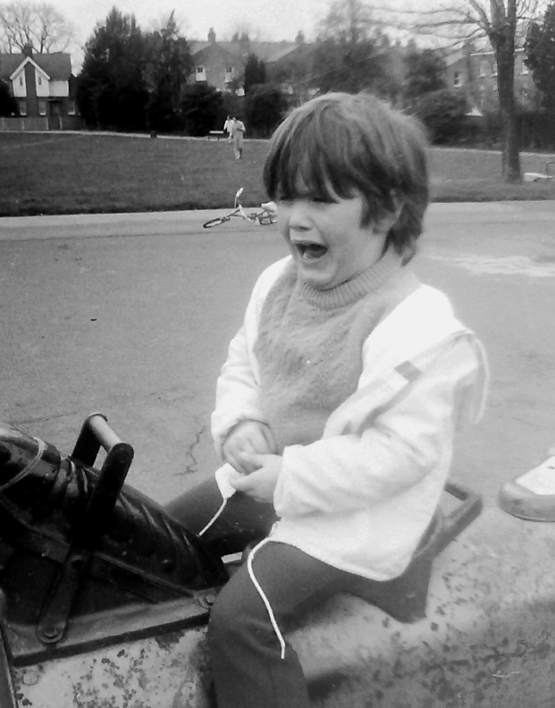
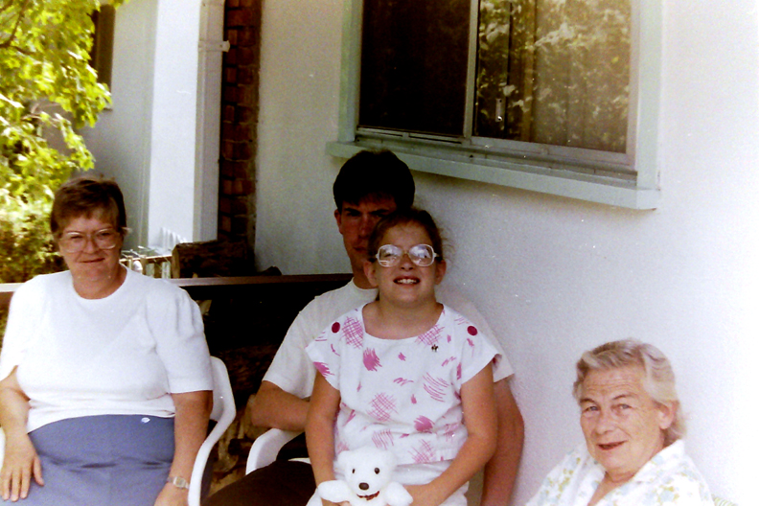
Perceptions of diversity and the parent/self-advocate divide
Damian E. M. Milton MA, PGCert, BA (Hons), Dip (conv), PGCE, Mifl, MBPsS

Slide 2
How is autism defined?
Medical/behavioural model – DSM-V.
The ‘triad of impairments’.
‘Passive, aloof, active-but-odd’.
‘High and low functioning’.
‘Verbal, non-verbal, and pre-verbal’.
‘Severe and mild’.
A cognitive difference and ‘spiky profiles’?
A socially constructed entity?
An embodied neurological diversity...

Slide 3
A case study: Damian and son
Personal story as theoretically relevant in the production of knowledge.
‘Formal’ similarities – both diagnosed on the autism spectrum.
‘Formal’ differences – current diagnosis of Asperger’s, and my son – autism with severe learning difficulties and global developmental delay.
No ‘disability’ welfare support vs. highest level of DLA.

Slide 4
Differences
Verbosity...however...maybe not quite so different after all.
IQ? High-end ‘spikes’ in the profile?
Schooling.
Circumstances of upbringing.
‘Regression’ – synaptic pruning and the increase in autistic ‘behaviours’.
Independence, autonomy and voice – level of dependence on others for support.
He’s better looking than me!

Slide 5
Similarities
‘Monotropic’ attention and being ‘detail-focused’.
Sensory sensitivity – creatures of comfort.
Taste in food / diet.
Open spaces and nature.
Clumsiness + perfectionism.
Self-driven.
A love of music.
A love of gadgets.
An exploratory outlook.
‘Dynamic quality’ (Pirsig, 1991).

Slide 6
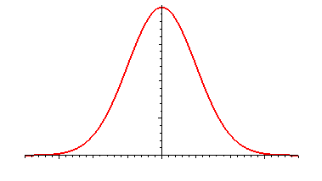
The bell curve and normalcy
‘Extremes of any combination come to be seen as 'psychiatric deviance'. In the argument presented here, where disorder begins is entirely down to social convention, and where one decides to draw the line across the spectrum.’ (Milton, 1999 - spectrum referring to the 'human spectrum of dispositional diversity').

Slide 7
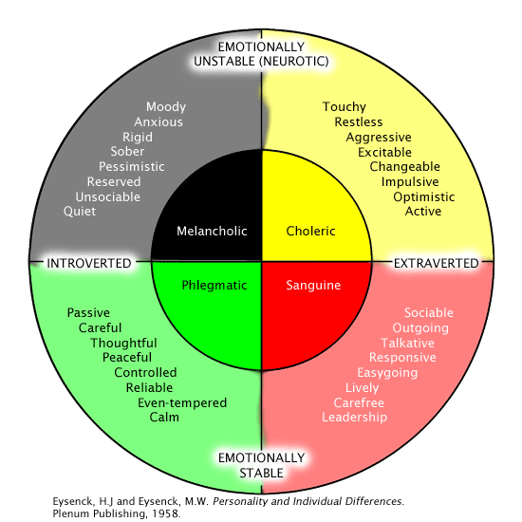
Hippocrates and the theory of personality

Slide 8
Parental ‘advocacy’ and its exploitation
‘Don’t mourn for us’ (Sinclair, 1993).
The bereavement process of the ‘warrior mum’. Parental transition – fighting autism to fighting for service provision.
‘You can’t rule it out!’ – the ‘kitchen sink’ approach (Milton, 2011).
Exploitation by the autism ‘industry’ and ‘quackery’.
ABA ‘works’ (Maurice, 1993).
The ‘high-functioning’ don’t know ‘what it’s like’.
Parent as ‘expert’ – what is and is not understood?

Slide 9
‘Extreme love’...
Small sample of responses to program on public internet forums taken for the purposes of this presentation.
15 commentators sampled from 5 different forums.
Included 2 ‘dads’ – one trying to sell products – the other responded to a mum who wanted the program to talk about the causes of autism, he was then ‘attacked’ by this mum. The two then got into a heated debate regarding MMR, where he called her a ‘babbling idiot’ and she accused him of being ‘brainwashed’.

Slide 10
...comments from mums...
10 mum’s – only one criticised the techniques used and then only mildly.
The main criticisms levied were regarding the lack of explanation of what autism was, or what caused ‘challenging behaviour’ or ways to ‘manage it’.
Another common criticism was that the film was not made in the UK.
One suggested that a program should be made about the stigma that parents of autistic children face.

Slide 11
...and quotes...
“More explanation is needed on explaining the techniques and interventions used and why they work for these children.”
“It should have explained autism in terms of the triad of impairments.”
“I found that I could relate to a lot of what I saw.”

Slide 12
Comments from people on the spectrum...
3 people on the spectrum – one young male who made a comment about the causes of autism not being relevant to the intentions of the program, to which a mum accused him of being ‘patronising’.
One who was a mum herself criticised the program for the lack of privacy and respect shown to the children in the program.
Lastly, another adult woman on the spectrum was heavily critical of the techniques shown in the program:

Slide 13
“I've just watched the Autism programme and, to be honest, I found it very uncomfortable. I felt the parents didn't give their children any time to process questions and used a very harsh tone of voice when talking to them. The restraint scenes were quite distressing. Both parents and teachers restrained the children immediately, without any warning. It was interesting to see that one parent had changed her approach at the end of the programme and chosen to send her son to his room rather than restrain him.”

Slide 14
I entered the debate myself on one of these forums, criticising the program and the techniques shown. This was a general comment, yet I got the following response:
“...as you said we all have our own opinions, so I have to agree to disagree with you on this one!”

Slide 15
A ‘common ground’?
Reasoned public debate – ‘safe’ forums?
Building alliances – avoiding manipulators.
Logos, ethos, pathos (Aristotle, 1991).
The contradictory balancing act of parental narratives – caught between ‘two worlds’.
‘Practitioners’ – the common enemy? Or ‘policy makers’, ‘decision-making bodies’ and educational theorists...well, some of them anyway...? Access to knowledge production itself.
There is no convincing a ‘zealot’ – but publicly disagreeing with them can help others see your logic.
A word of warning...sometimes one needs to ‘take a break’!

Slide 16
References
Aristotle, trans. by G. Kennedy (1991) On Rhetoric: A Theory of Civic Discourse. Oxford: Oxford University Press.
Maurice (1993) Let Me Hear Your Voice: A Family’s Triumph Over Autism. London: Robert Hale.
Milton (1999) The Rise of Psychopharmacology. Masters degree essay – unpublished.
Milton, D. (2011) ‘Parenting, discipline, and educational preferences for children on the autistic spectrum – a survey of parental attitudes.’ 10th Annual Postgraduate Education Conference. University of Birmingham.
Pirsig (1991) Lila: an Inquiry into Morals. London: Black Swan.
Sinclair, J. (1993) “Don’t Mourn For Us”, http://www.autreat.com/dont_mourn.html, - accessed 10/11/09.

